Slide 1
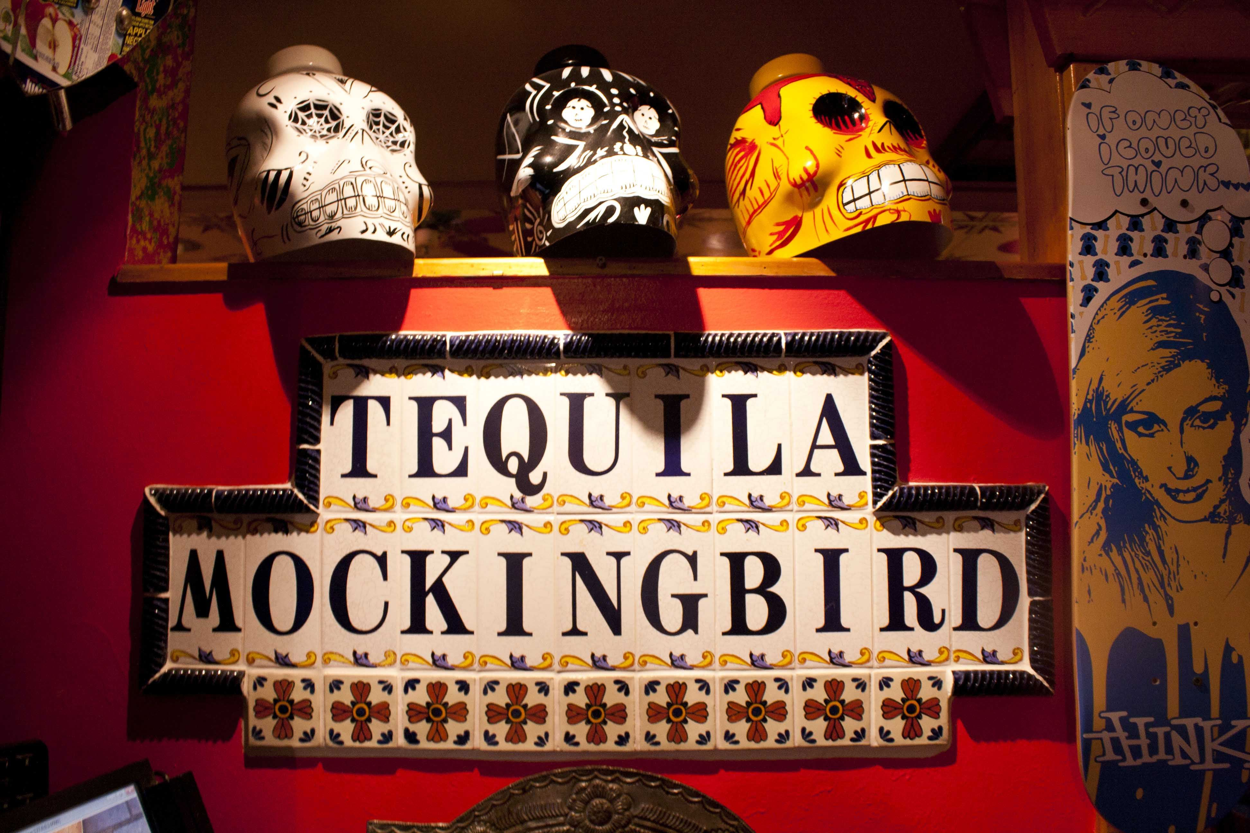

Slide 2
The-Mockingbirds
Correlation of Obesity and Food Options by City Population
Team Members: Liliana Ilut, Vasil Nenov, Quentin Sloboda
Exploring the correlation between number and type of restaurants and obesity rate in the top 300 counties by population
Research Questions to Answer:
Does the amount of restaurants in a city equal a higher obesity rate
Can the type of restaurant in a city be a predictor of a citys economic standing
Does a city with a higher economic standing have a lower obesity rate
Is there a particular correlation between cuisine/type of restaurant and obesity
Is there a correlation between economic status and cuisine?

Slide 3
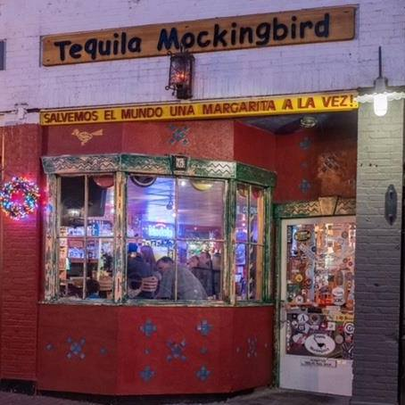
Address: 6 Forest St, New Canaan, CT 06840

Slide 4


Slide 5
Data Sets Used
Top 300 U.S. Counties by Population
Household Income
Obesity Percentage
Number of Restaurants

Slide 6
Top 300 Counties by Population

Slide 8
Household Income by County

Slide 10
Obesity Percentage by County

Slide 11

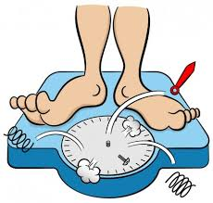
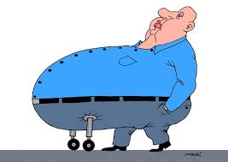

Slide 12
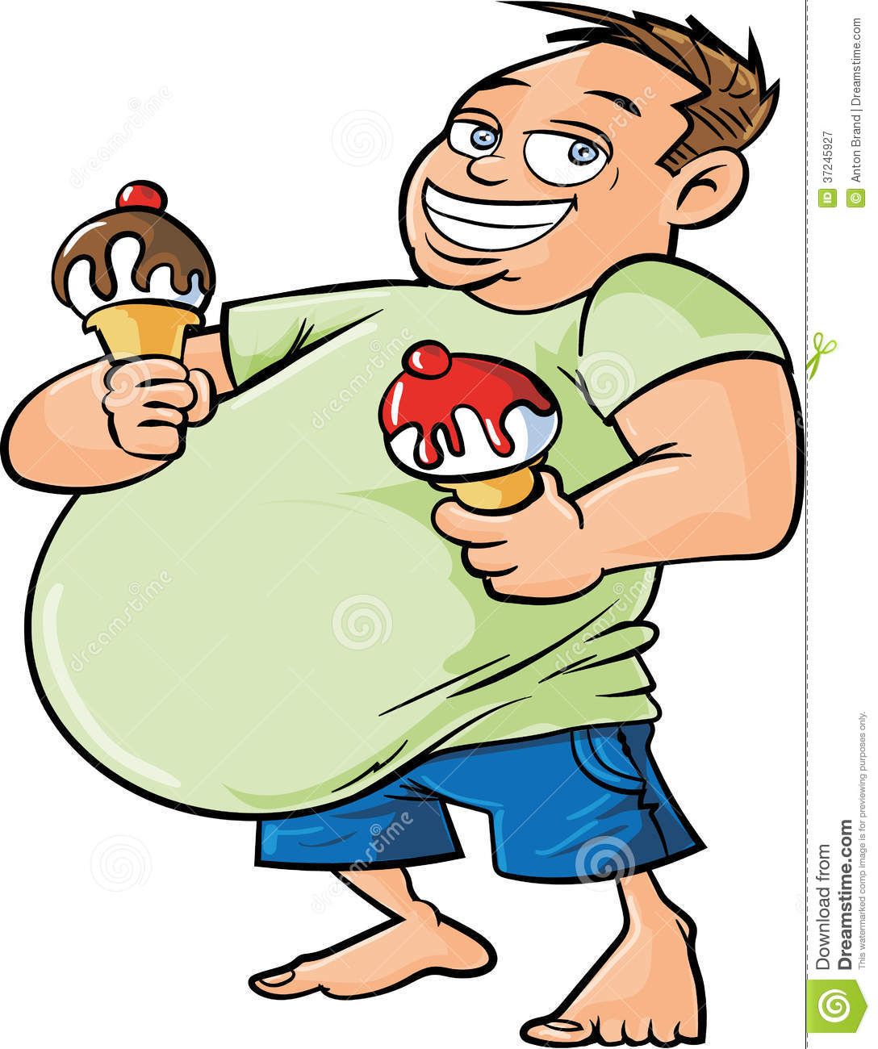

Slide 13
Number of Restaurants

Slide 14


